Slide 1
PARK SERVICE
-By Services 2u

Slide 2
Agenda
Introduction
Mission
About Company
Softwares
Screens
Problems Faced

Slide 3
Introduction
Product Name: Park Services
Company Name: Services 2u
Team Members:
Navneet Kaur
Rajesh Kumar
Sukhmandeep Kaur
Kuljeet Singh

Slide 4
MISSION
Park service enchances quality of life by providing clean and safe parking facilities, based on the pillars of the convenience, reliability and hospitality.

Slide 5
TOOLS USED
ATOM
GOOGLE CHROME
HTML/CSS/JAVASCRIPT
POWERPOINT

Slide 6
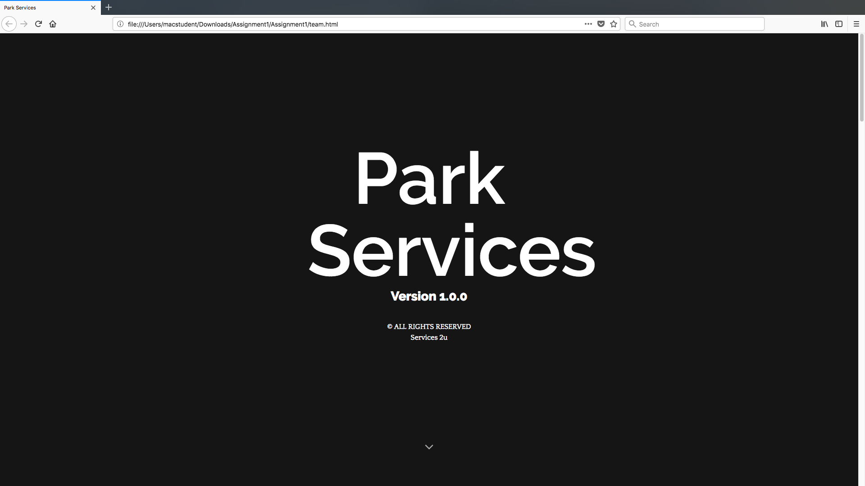

Slide 7
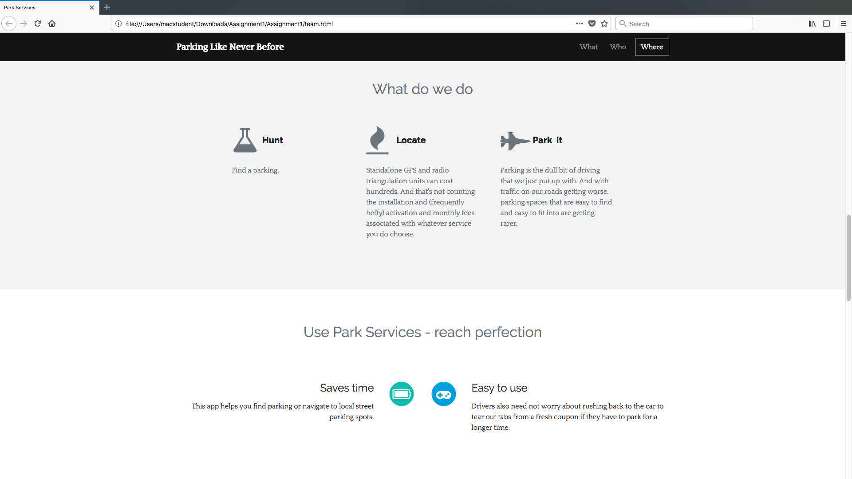

Slide 8
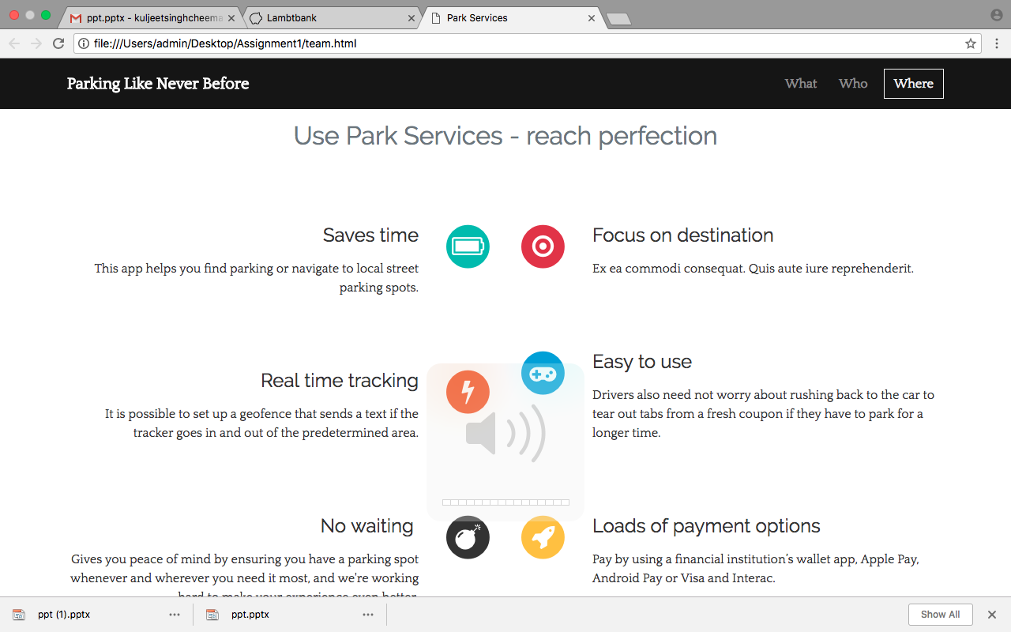

Slide 9
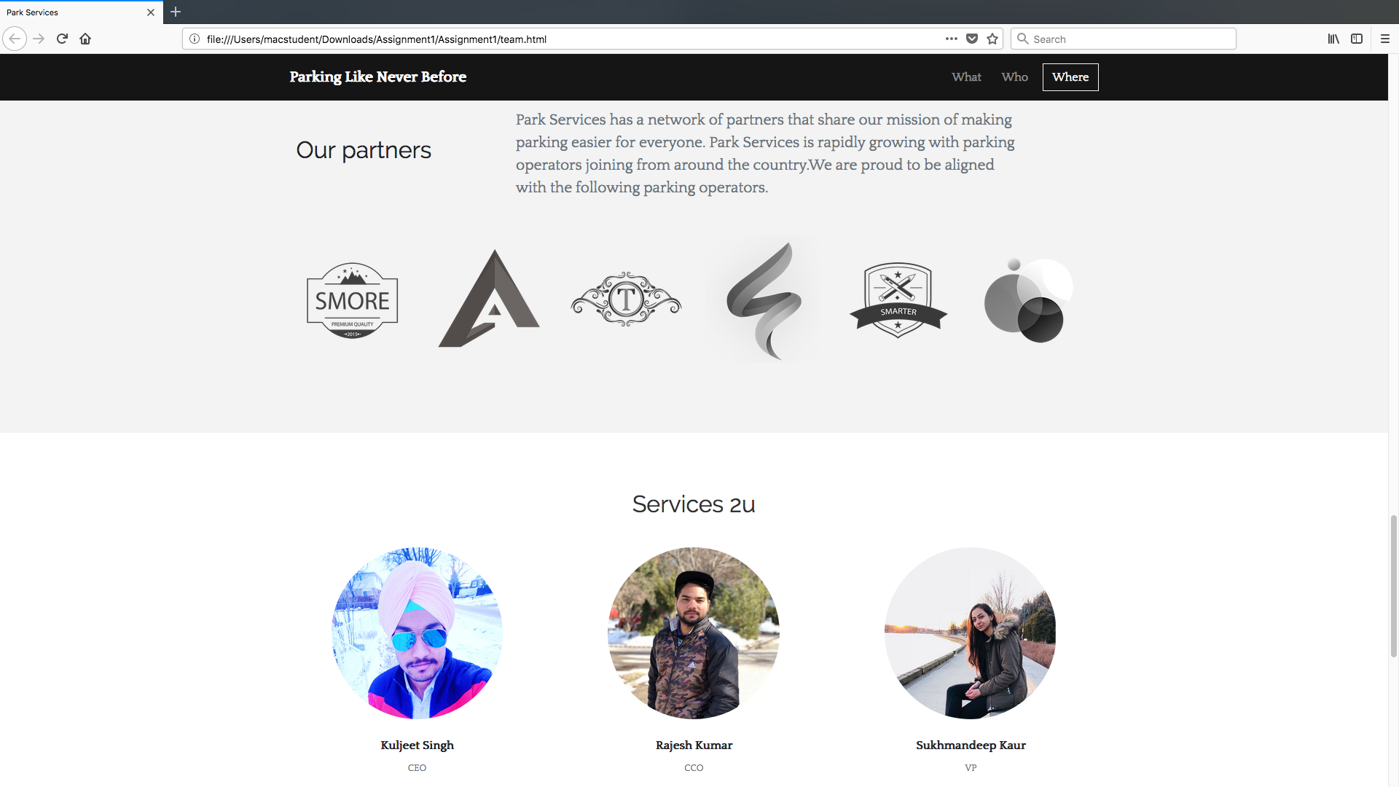

Slide 10
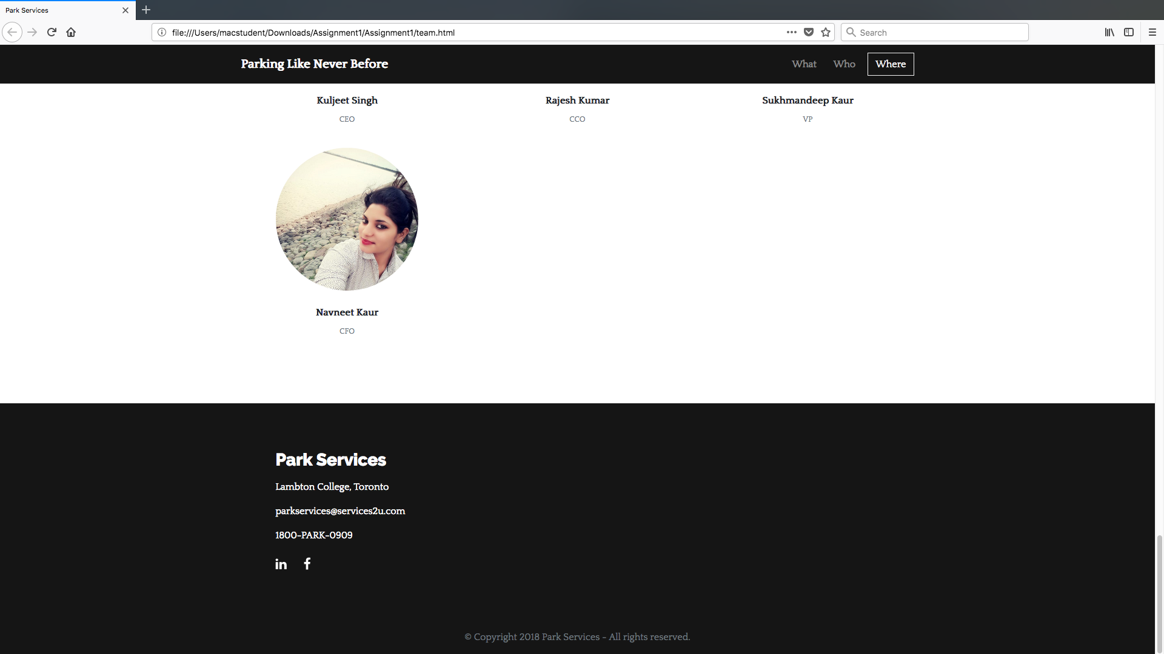

Slide 11
Launching Webpage
It is a first screen of website.
It shows copmany name along with some links .
By clicking on links next pages are open.
Screen shows what , why and where.
In the next part web page, it shows the team members.

Slide 12
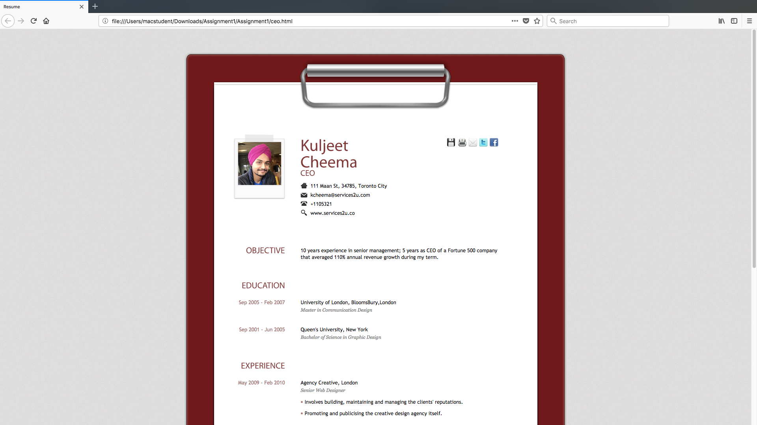
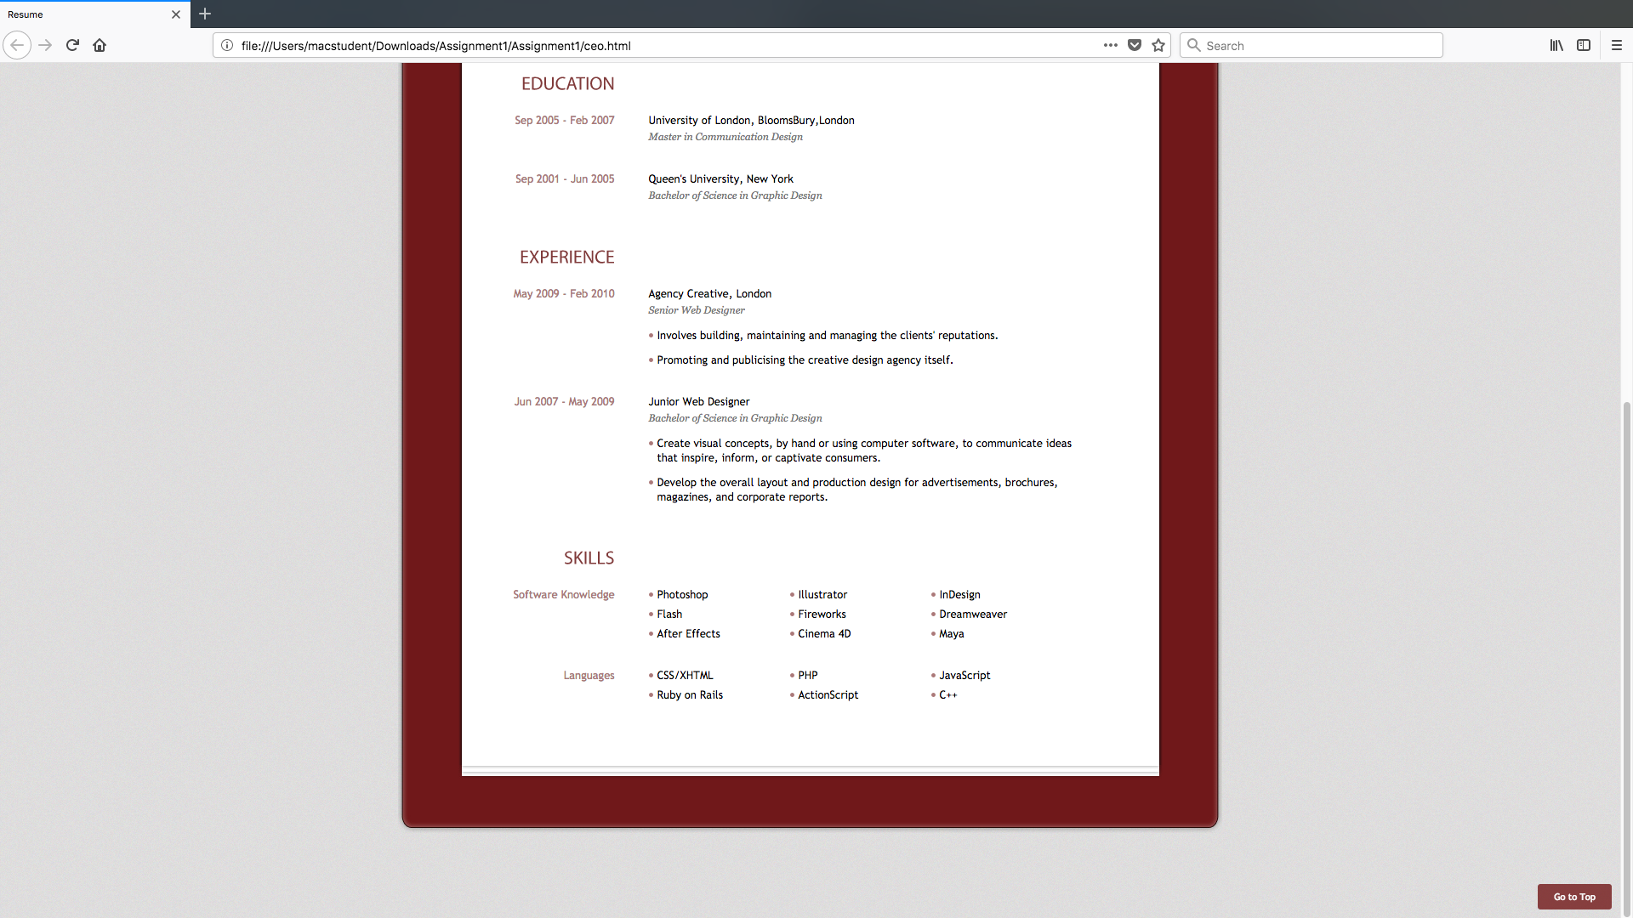

Slide 13
Team Members
Kuljeet Singh
CEO of this company.
This page give all valid information OF Kuljeet Singh such as:
Education
Experience
Skills
Personal Information

Slide 14
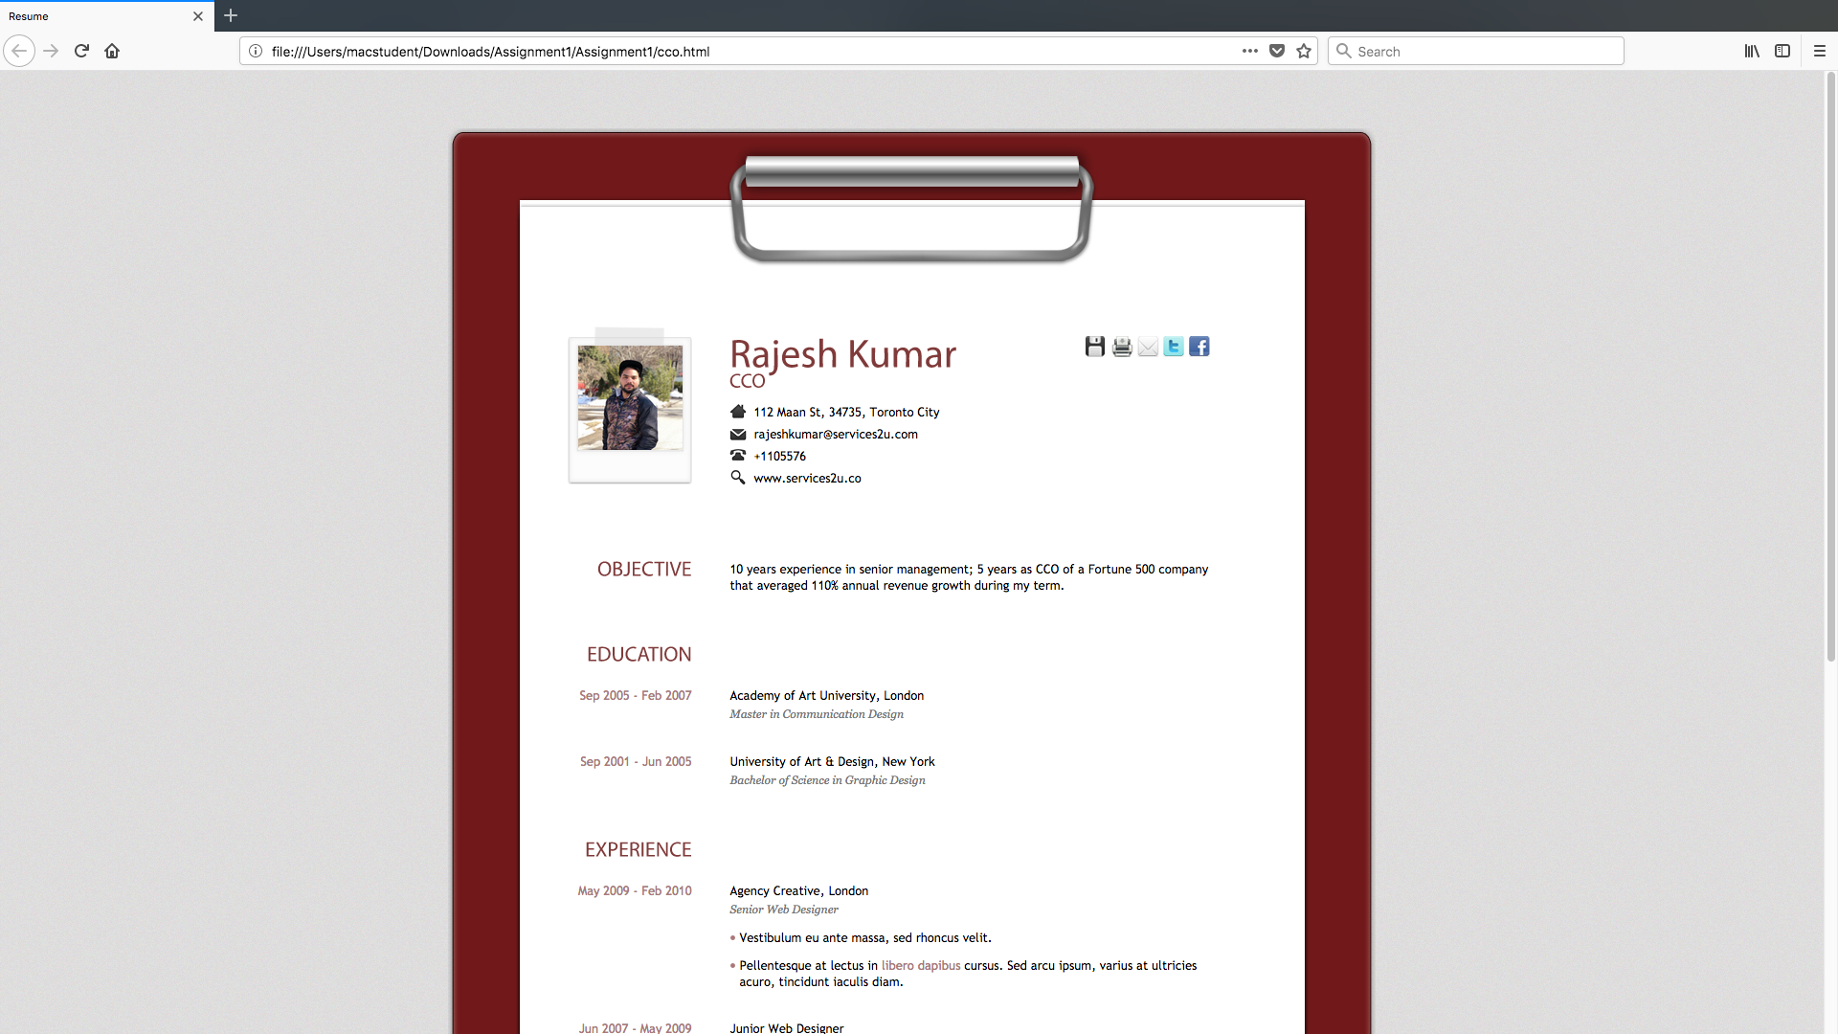
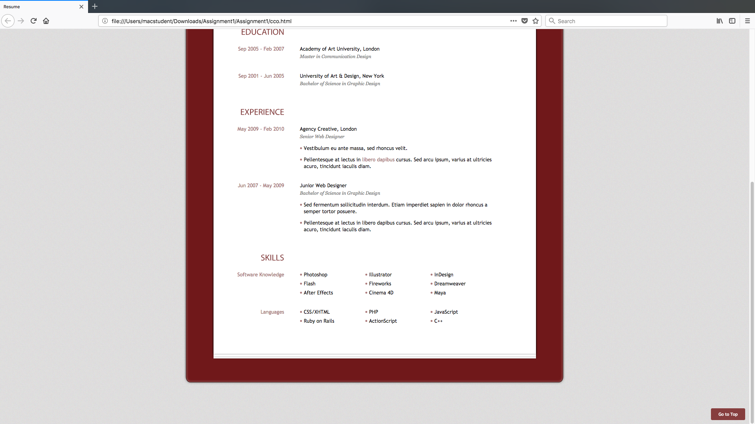

Slide 15
Rajesh Kumar
CCO of a company.
Has an experience from 2007 june.
Also has a software skills like,
Photoshop
Flash
Cinema 4d
He also has a knowledge of few languages.

Slide 16
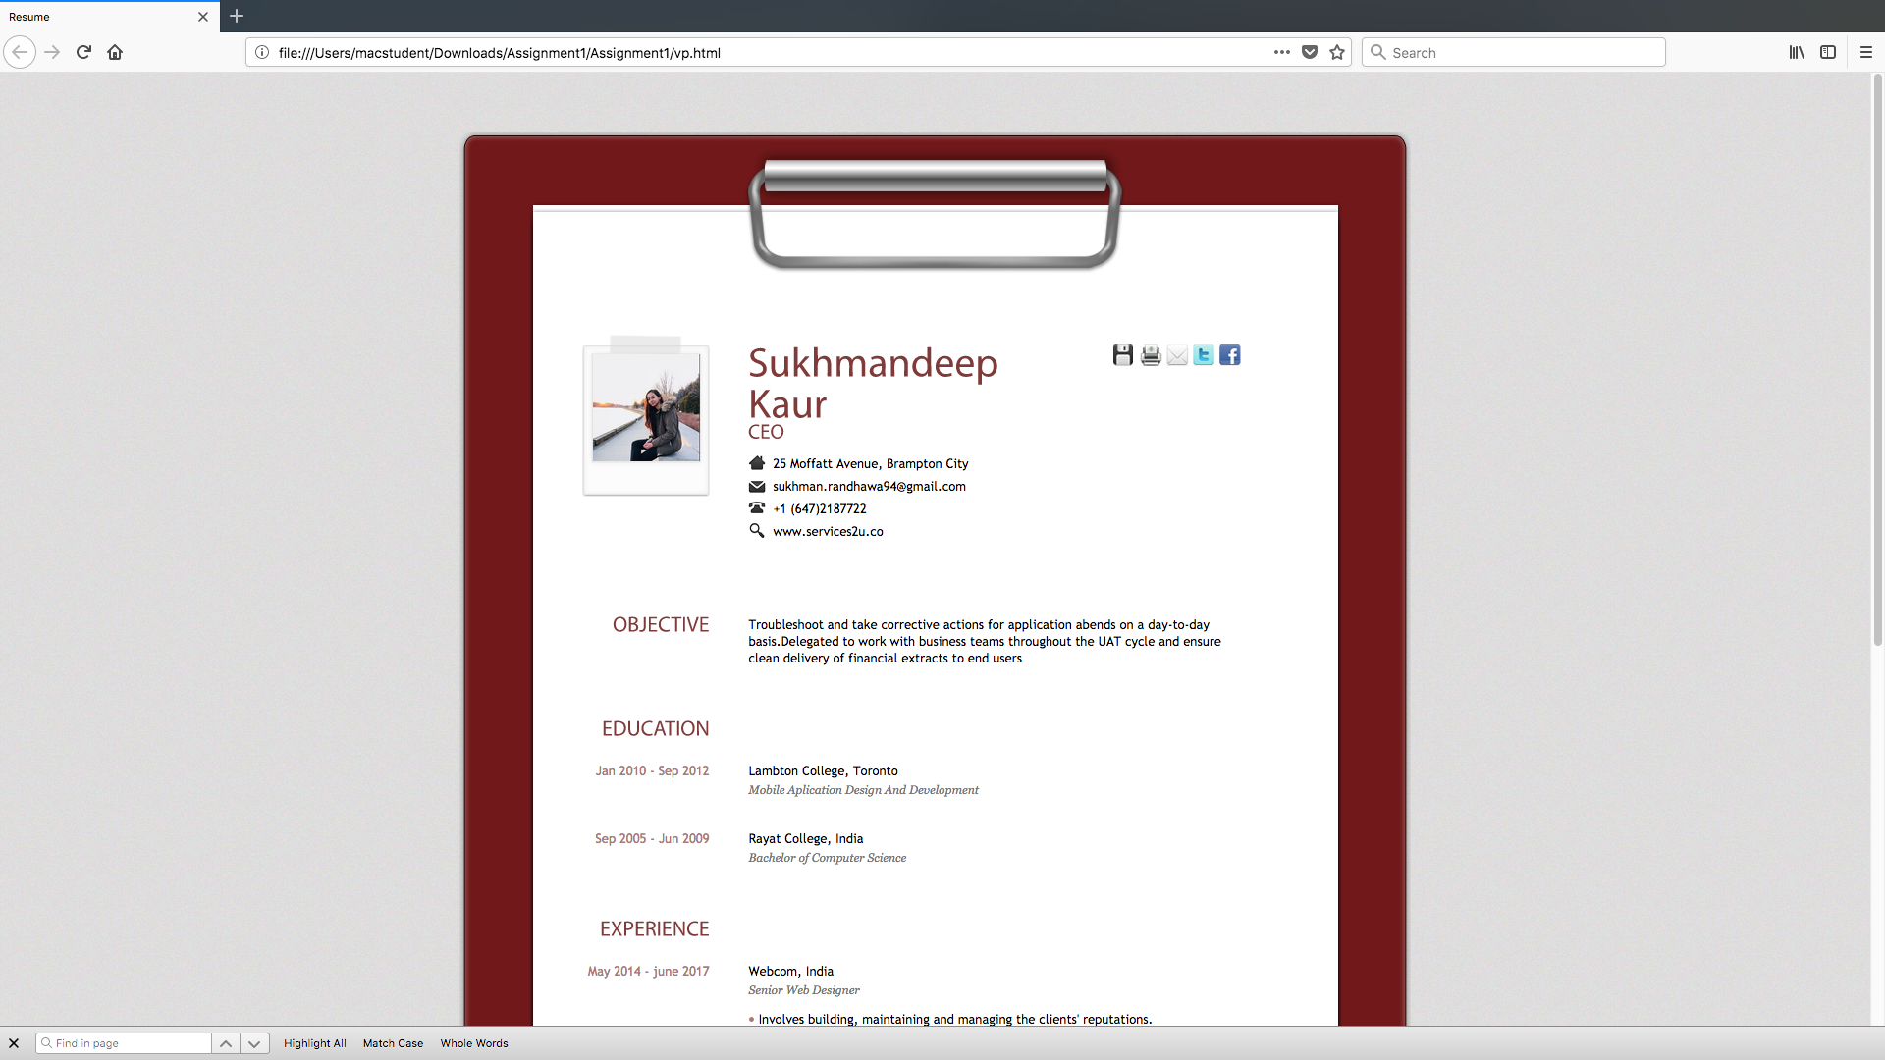
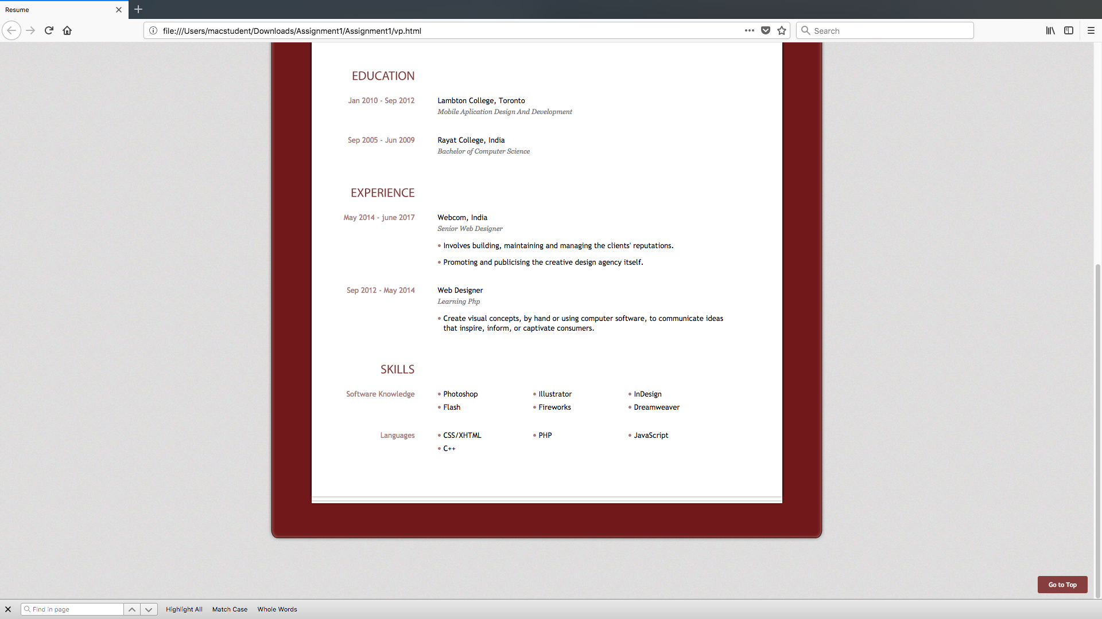

Slide 17
Sukhmandeep Kaur
Sukmandeep kaur give her information such as phone number, email address.
Another information regarding sukhmandeep includes:
Education
Work Experience
Skills regarding languages and tools.

Slide 18
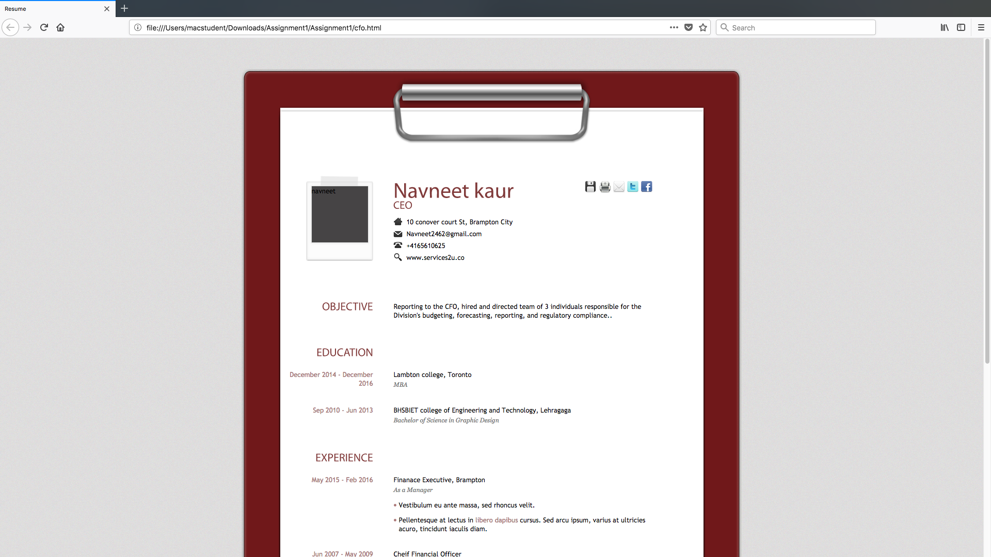
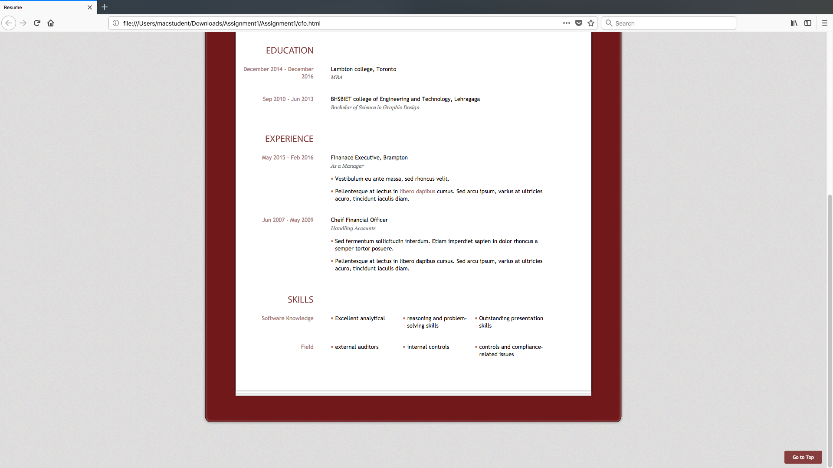

Slide 19
Navneet Kaur
She is a CEO of a company
She shows her all information in the webpages regarding :
her personal information
her experience
her education
her skills

Slide 20
Problems Faced
New to atom environment.
Code of javascript
Errors in programming

Slide 21
Thank You

